Slide 1
Tutorial 6 – STAR
23 October 2020
MICB405

Slide 2
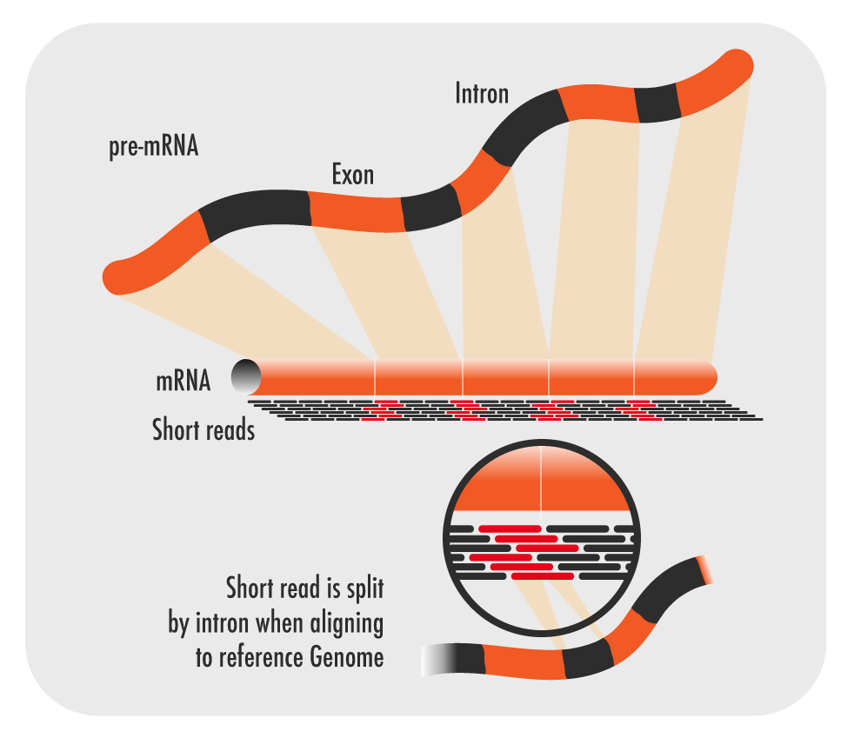
RNA-seq review
Examines the quantity and sequences of RNA from a sample
Transcriptome
Different tissues and conditions, even within the same individual, will yield different results

Slide 3
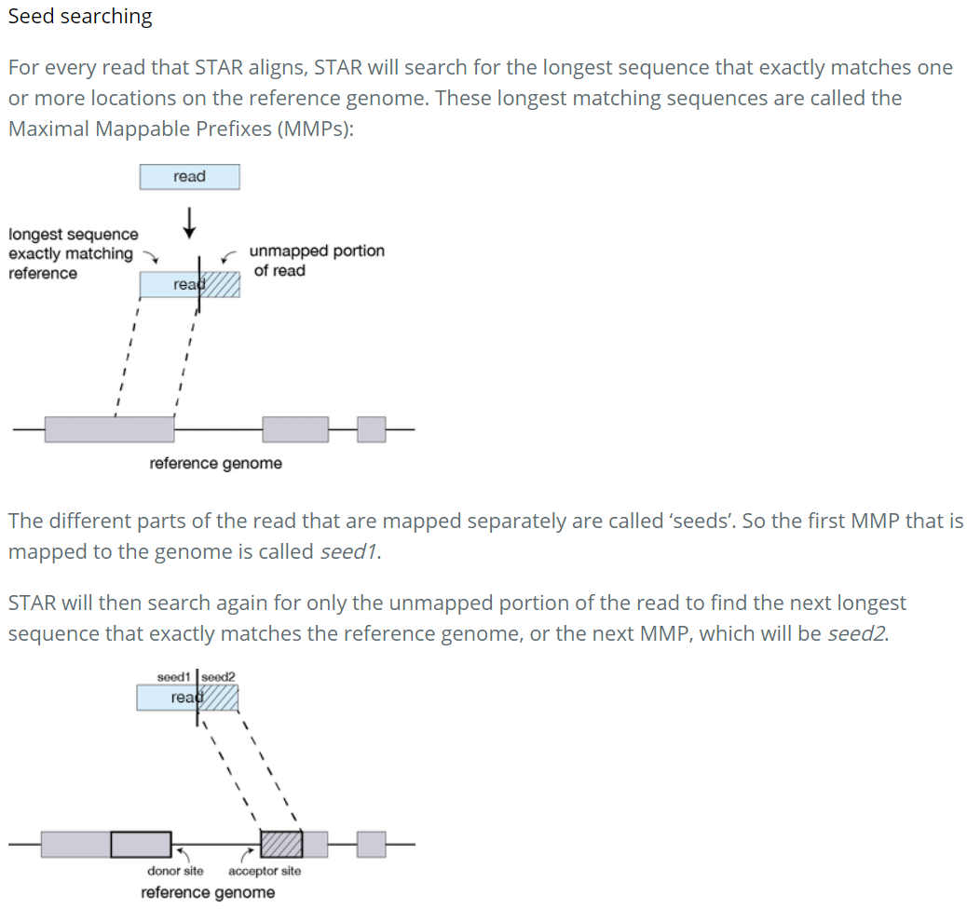
What is STAR
Alignment software for RNA-seq experiments
Intron/exon-aware
Inputs
FASTA
FASTQ
GTF

Slide 4
Gene Transfer Format (GTF)
Consists of one line per feature, each containing 9 columns of data, plus optional track definition lines. The following documentation is based on the Version 2 specifications.
Fields must be tab-separated. Also, all but the final field in each feature line must contain a value; "empty" columns should be denoted with a '.'
seqname - name of the chromosome or scaffold; chromosome names can be given with or without the 'chr' prefix. Important note: the seqname must be one used within Ensembl, i.e. a standard chromosome name or an Ensembl identifier such as a scaffold ID, without any additional content such as species or assembly. See the example GFF output below.
source - name of the program that generated this feature, or the data source (database or project name)
feature - feature type name, e.g. Gene, Variation, Similarity
start - Start position* of the feature, with sequence numbering starting at 1.
end - End position* of the feature, with sequence numbering starting at 1.
score - A floating point value.
strand - defined as + (forward) or - (reverse).
frame - One of '0', '1' or '2'. '0' indicates that the first base of the feature is the first base of a codon, '1' that the second base is the first base of a codon, and so on..
attribute - A semicolon-separated list of tag-value pairs, providing additional information about each feature.

Slide 5
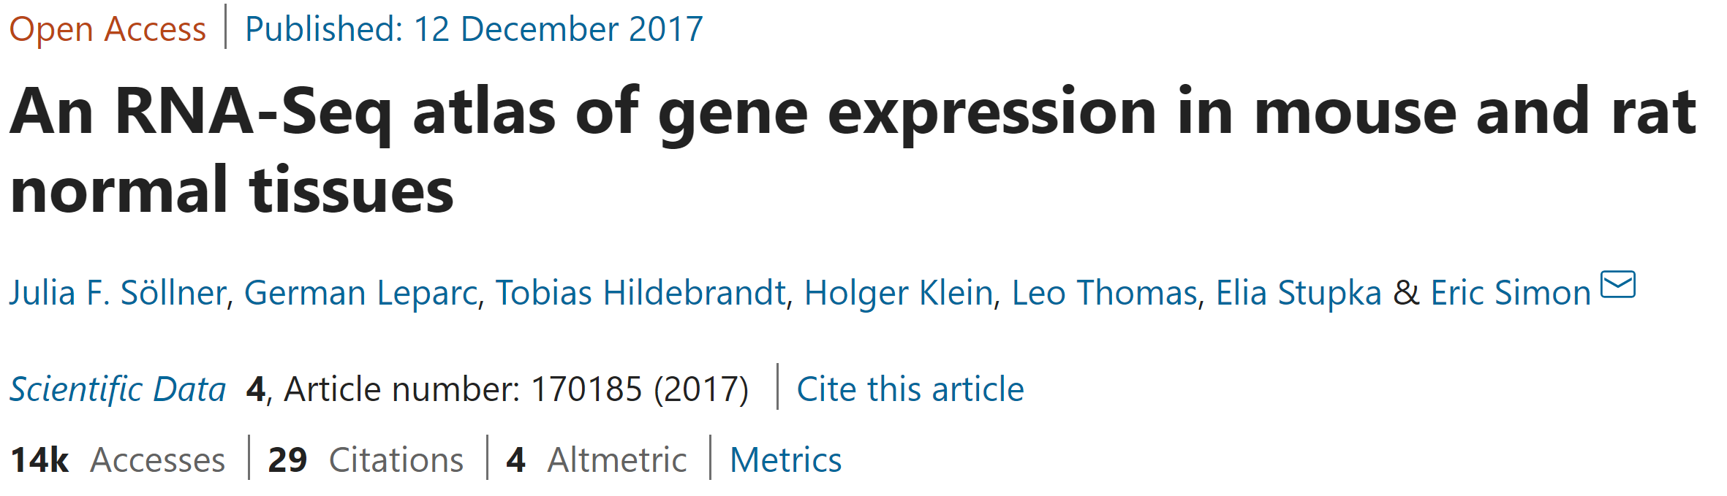
Tutorial Background
Freely-accessible data
Panel of normal tissue RNA-seq assays done on multiple organs for 3 different male mouse individuals
Study of inter- and intra-species variation in gene expression

Slide 6
Variant Calling

Slide 7
Variant Calling
Single-nucleotide variant
Single-nucleotide variant
Insertion or deletion (indel)
Let’s find them!

Slide 8
Peak Calling

Slide 9
Peak Calling
These are peaks – their locations are linked to the epigenomic mark that is being studied

Slide 10
RNA-seq Analysis
RNA-seq reads
Genome, hypothetically ignoring introns

Slide 11
RNA-seq Analysis
FASTQ
RNA-seq reads
Gene 1
Gene 2
Gene 3
Genome, hypothetically ignoring introns
FASTA
GTF

